Slide 1
State Space Models on Temporal Graphs A First-Principles Study: The GRAPHSSM Framework
Jintang Li · Ruofan Wu · Xinzhou Jin · Boqun Ma · Liang Chen · Zibin Zheng
Ankit Kumar Singh

Slide 2
Roadmap
1. The Problem
Why static models fail on dynamic graphs
2. Previous Architectures
RNNs, Transformers, and early SSMs — limitations
3. HiPPO Framework
The mathematical backbone of modern SSMs
4. GHIPPO Abstraction
Extending HiPPO to graphs via Laplacian regularization
5. Unobserved Mutations
The discretization dilemma & oracle solution
6. Mixed Discretization
Practical approximation strategy
7. Results & Insights
Empirical validation and key findings

Slide 3
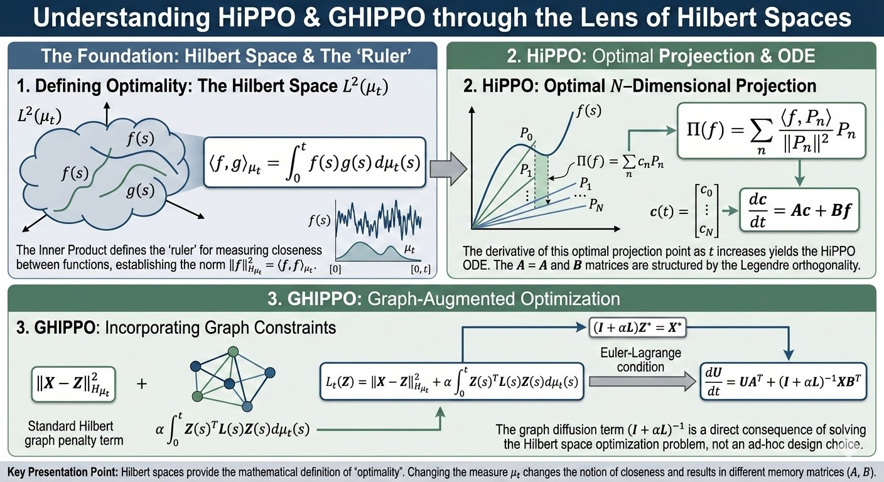
Hilbert Space

Slide 4
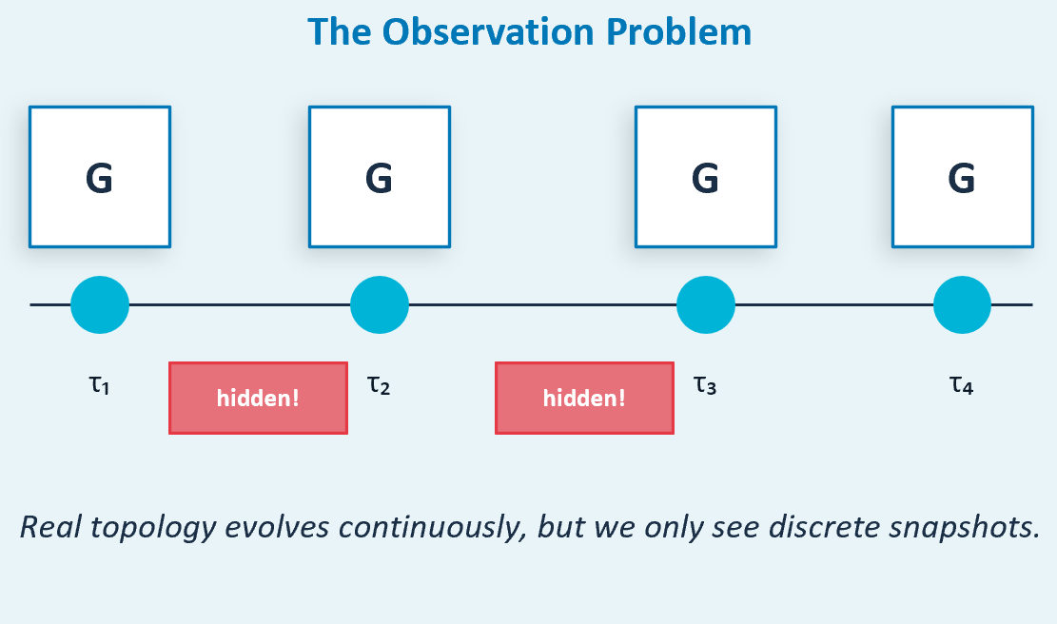
The Problem: Real-World Graphs Are Dynamic
Real-World Dynamic Systems
Social networks, traffic grids, brain connectomes, and financial networks all evolve continuously — edges are inserted and deleted between discrete observations.
Core Challenge: Graph mutations are entirely unobserved, yet they fundamentally shape future states.
The Observation Problem
We only observe discrete snapshots at times τ₁, τ₂, τ₃, ... The true topology evolves continuously in the gaps between observations.
Hidden mutations mean we never see the actual graph structure during each interval — only the endpoints.

Slide 5
Previous Architectures & Their Limitations
RNNs / LSTMs / GRUs
Era: 1990s–2010s
How it works: Process sequences step-by-step via recurrence
Strengths:
✓ Natural recurrence
✓ Constant memory
✓ O(N) complexity
Limitations:
✗ Vanishing gradients
✗ Forgets early history
✗ No structural awareness
Transformers
Era: 2017–present
How it works: Self-attention creates full context matrix
Strengths:
✓ Captures global context
✓ Fast parallel training
✓ O(n²) memory
Limitations:
✗ O(n²) memory/compute
✗ Not inherently sequential
✗ Slow inference
SSMs (S4, Mamba)
Era: 2022–present
How it works: Discretize ODE as linear recurrence
Strengths:
✓ O(N) linear complexity
✓ Fast training
✓ Long-range memory
Limitations:
✗ No structural awareness
✗ Independent dimensions
✗ No topology

Slide 6
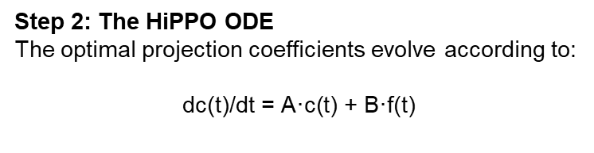
The HiPPO Framework: Optimal Memory for Sequences
Key Insight
Instead of learning memory via ad-hoc gates (LSTM), HiPPO asks: "What is the mathematically OPTIMAL way to compress a continuous history signal into a fixed-size state?
Step 1: The Projection Problem
Given continuous input f(t), find compressed state c(t) that best approximates entire history f(0...t) using N basis polynomials.
Projection: Π(f) = Σ ⟨f, Pₙ⟩ Pₙ / ||Pₙ||²
Step 2: The HiPPO ODE
The optimal projection coefficients evolve according to:
$$\text{dc}\text{(}\text{t}\text{)/}\text{dt}\text{ = }\text{A}\text{·}\text{c}\text{(}\text{t}\text{) + }\text{B}\text{·}\text{f}\text{(}\text{t}\text{)}$$
A (State Matrix)
Derived from Legendre polynomials. Controls how old memories decay and rotate — ensures gradients never vanish.
B (Input Matrix)
Routes current input into polynomial basis. Injects new signals into the right frequency band.
Result
Infinite context, O(N) memory, zero vanishing gradients — mathematically optimal compression.

Slide 7
The Gap: Why Standard SSMs Fail on Temporal Graphs
✓ Standard SSM on Text/Audio
✓ Inputs are independent dimensions
✓ Token 1 does not depend on Token 2
✓ Each position processed independently
✓ No topology to exploit
✗ Standard SSM on Temporal Graph
✗ Node features are NOT independent — Node A and B are connected, their features influence each other
✗ Topology changes over time — Adjacency matrix L(t) mutates, but SSM sees no structure
✗ Missing relational inductive bias — Ignoring edges throws away most informative signal
Problem: Processing node features independently treats a social network like 10,000 unrelated audio tracks — fundamentally wrong assumption.

Slide 8
GHIPPO: Graph-HiPPO — The Core Innovation
From Independent Memory Compression to Structure-Aware Memory Compression
The GHIPPO Idea in Plain English
When compressing history, we add a penalty for adjacent nodes having very different compressed memories. This forces the model to learn history in a way that respects graph structure — connected nodes should tell a consistent story about the past.
The Innovation
The Laplacian regularizer Z(s)ᵀ L(s) Z(s) penalizes memory differences between topologically connected nodes. Minimizing this forces adjacent nodes to have similar histories.
Term 1: Feature Accuracy
L_t = ∫||X(s)−Z(s)||² dμ_t(s)
Memory Z(s) must accurately reconstruct node features X(s) at each moment. Standard HiPPO compression term — nothing changes here.
Term 2: Laplacian Regularizer
+ α·∫Z(s)ᵀ L(s) Z(s) dμ_t(s)
The graph Laplacian L(s) encodes "who is neighbors with whom" — minimizing this forces adjacent nodes to have similar histories.

Slide 9
Theorem 1: The GHIPPO ODE — Derived from First Principles
THEOREM 1 (The GHIPPO ODE)
For a temporal graph G evolving with M mutation events, the optimal memory state U(t) ∈ ℝ^(Nᵥ×N) satisfies:
for t ∈ [t_{m-1}, t_m)
dU(t)/dt = U(t)Aᵀ + (I + αL(t))⁻¹ · X(t) · Bᵀ
U(t)Aᵀ
Temporal Decay (Memory Aging)
A is the HiPPO-LegS matrix. This term makes old memories fade according to mathematically optimal Legendre polynomial decay — not randomly, but in structured way that preserves important long-range patterns.
(I+αL(t))⁻¹
Infinite Spatial Diffusion (New!)
Key innovation. Before updating memory, features are diffused across entire graph structure infinitely many times. Equivalent to running message-passing until convergence — every node's history is smoothed by its neighborhood.
X(t)·Bᵀ
New Input Injection
B routes the current (diffused) input into polynomial basis of state space. Same as standard HiPPO — inject new information into the state.

Slide 10
The Diffuse-Then-Update Mechanism
Stage 1 — Infinite Spatial Diffusion
Multiplying by (I + αL)⁻¹ is mathematically identical to running message-passing INFINITELY many times. Using Taylor expansion: (I + αL)⁻¹ = I − αL + α²L² − α³L³ + ... Each Lᵏ term is one more 'hop' of message passing across the graph. Summing all hops to infinity means every node absorbs information from ALL other nodes, weighted by distance.
Result: Fully denoised, globally smoothed features that respect the graph's topology.
(I + αL(t))⁻¹ · X(t)
Stage 2 — Temporal Memory Update
Once features are spatially smoothed, they are injected into the temporal state. U(t)·Aᵀ: Existing memory decays according to HiPPO matrix — long-range information preserved without vanishing gradients. diffused_input·Bᵀ: Spatially-denoised features added to state, encoded into polynomial basis defined by B.
The state U(t) is now BOTH temporally compressed (via HiPPO) AND spatially aware (via Laplacian diffusion).
dU/dt = U·Aᵀ + diffused_input·Bᵀ

Slide 11
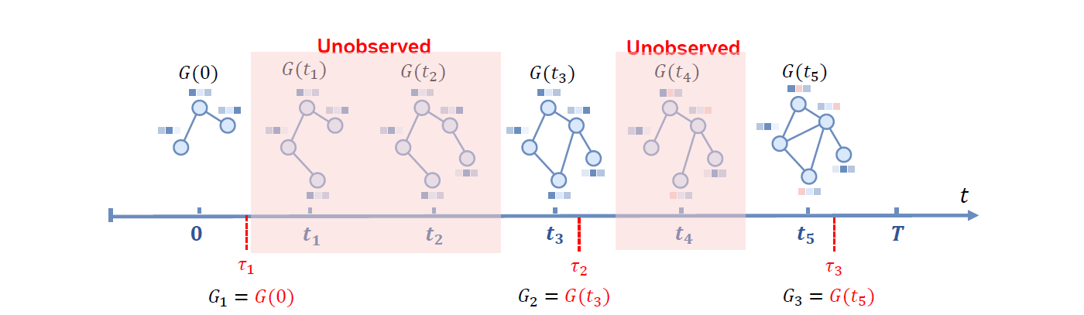
The Discretization Dilemma: Unobserved Graph Mutations
In Theory GHIPPO is Perfect. But Real Data is DISCRETE — and Mutations Happen in the Gaps We Can't See.
Why Standard ZOH Fails
Zero-Order Hold (ZOH) discretization assumes the system is STATIC between observations. It treats G₁ as the graph for the entire interval [τ₁, τ₂]. This is FALSE — the graph was actually mutating the whole time, and using G₁ for the full interval introduces systematic error.
What We Need
We need a discretization scheme that accounts for the unknown mutations between snapshots — blending the topology of G_{l-1} and G_l to form a best-guess "effective" input that represents the true (but unobservable) trajectory of the graph.

Slide 12
The Oracle Discretization
What would the perfect discrete update look like if we could observe all hidden graph mutations? Theorem 2 provides the mathematical answer.
Uₗ = Uₗ₋₁ · exp(Δₗ·A) + X̃ₗ · (exp(Δₗ·A) − I) · A⁻¹
where X̃ₗ = Σᵢ (I + αLₗ,ᵢ)⁻¹ Xₗ,ᵢ Λᵢ Bᵀ and Σᵢ Λᵢ = I
X̃ₗ represents a convex combination of all intermediate diffused node features, weighted by how long each graph topology persisted between mutations.
Uₗ₋₁·exp(ΔₗA)
Memory decay over time gap Δₗ via matrix exponential. Larger gaps induce more decay.
X̃ₗ·(exp−I)·A⁻¹
Convex blend of all hidden intermediate states. Weights proportional to topology persistence.
Λᵢ (weights)
Diagonal matrices summing to identity — partition of unity ensures no time double-counted.

Slide 13
Mixed Discretization: Making the Oracle Practical
Theorem 2 requires all hidden mutations — impossible in practice. We approximate using observed snapshots Gₗ₋₁, Xₗ₋₁ and Gₗ, Xₗ.
Spatial Diffusion
(I+αL)⁻¹ requires O(N³) dense matrix inversion — infeasible on large graphs.
Temporal Blending
Convex combination Σ Λᵢ needs unobserved mutation times.
Ordinary ZOH
X̂ᴼ = GNN(Xₗ, Gₗ)
No blending. Fast but ignores transitions.
Feature Mixing
X̂ᶠ = GNN(MIX(Xₗ₋₁,Xₗ), Gₗ)
Blend before diffusion. One MIX operation
Representation Mixing
X̂ᴿ = MIX(GNN(Xₗ₋₁,Gₗ₋₁), GNN(Xₗ,Gₗ))
Diffuse independently, then blend. Best performance.
Solution: Approximate (I+αL)⁻¹ with 1-layer trainable GNN. Taylor series shows (I+αL)⁻¹ ≈ I − αL, equivalent to GCN/SAGE message passing. Learn MIX module to blend snapshots and guess average intermediate state.

Slide 14
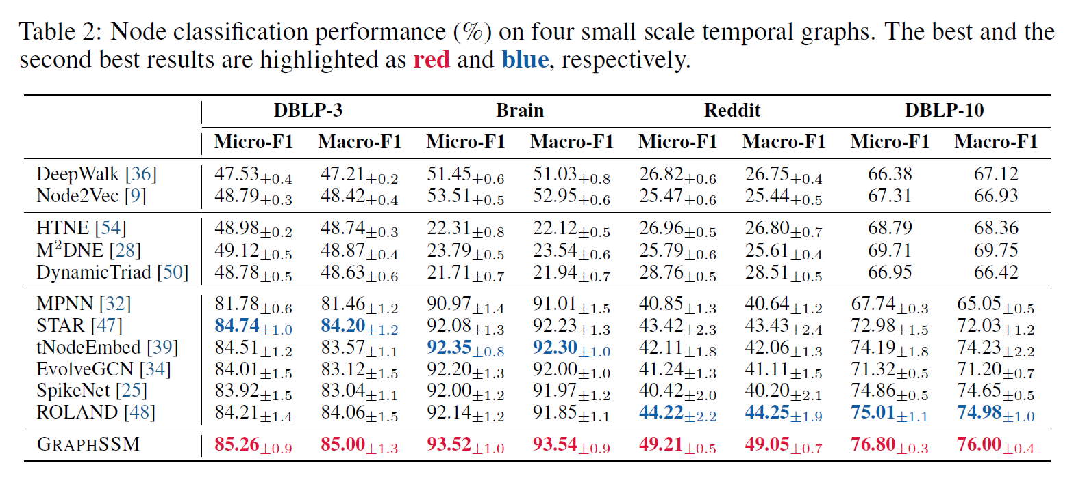
Results

